Slide 1

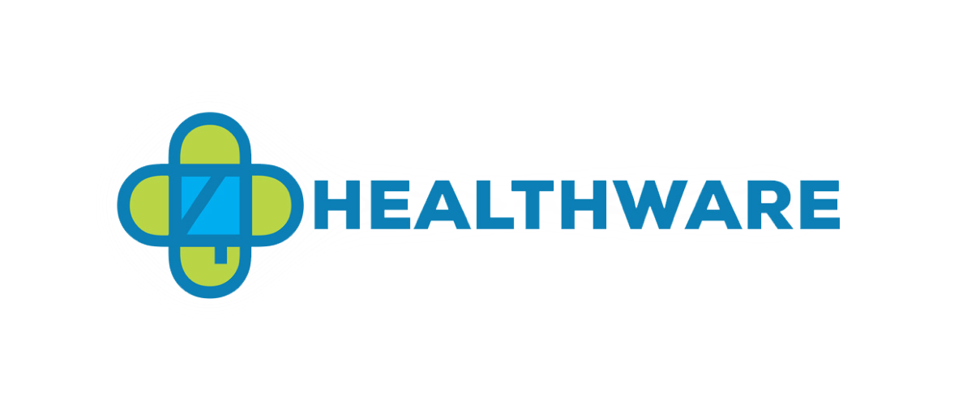

4D Healthware 401 N Michigan Ave Suite #1740, Chicago, IL 60611
4dhealthware.com
(224) 633-9472
PROPRIETARY AND CONFIDENTIAL
Not to be shared without prior approval of 4D Healthware
4D Healthware Voice Recognition
Adi Madan Anuj Satya Matta
Jahnavi Gulabani Satya Prakash
November 30th,2022

Slide 2
Agenda
About 4D Healthware
Objectives
Process
Deliverables
Voice Recognition Device vendors and HIPAA compliance
Analysis and Visualization Results
Use Cases
Summary
Future Scope

Slide 3
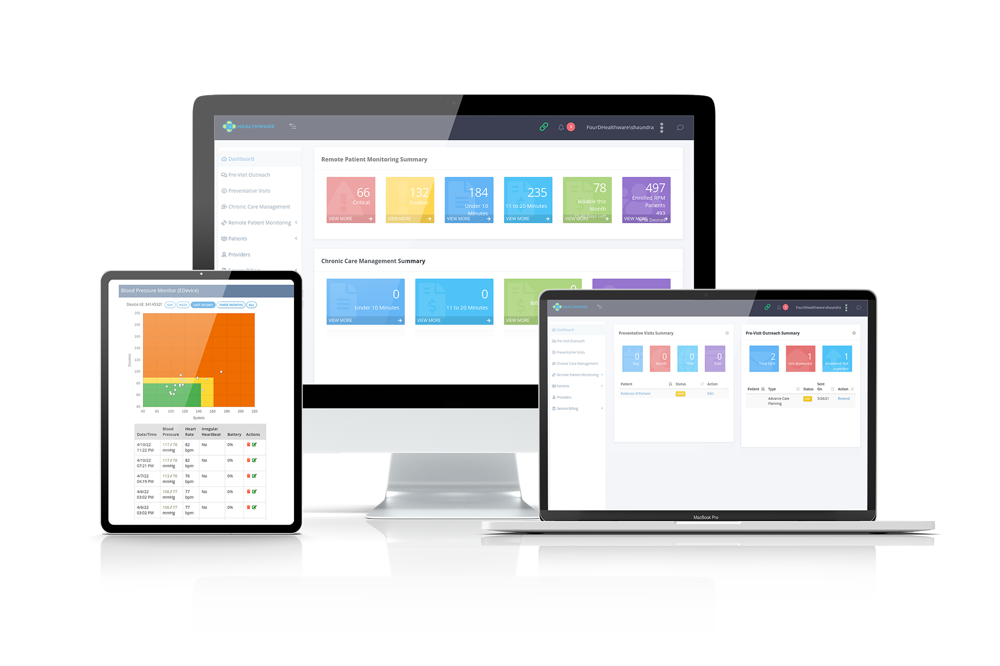
About 4D Healthware
4D Healthware mainly focuses on providing healthcare services using technology to help patients better self manage themselves
4D mainly caters to patients suffering from chronic illnesses like Diabetes,Hypertension,Asthma
The customers for 4D Healthware are the health plans who have their set group of patients and clinicians at hospitals that are associated with the health plans
The end consumers for 4D Healthware are patients who are financially weak and cannot afford the same level of healthcare as others

Slide 4
Objectives
Our Objectives are:
To understand the issues faced by the patients
Develop use cases that meets the needs of the patients using voice recognition technology
Profile a list of companies that offer voice based technology solutions for patients
Segregation of companies based on primary voice technology areas

Slide 5
Problems that can be addressed with VR
Self Management
Medication Adherence
Managing their daily routine
Lack of Awareness
Inconsistency in self diagnosis
Lack of proper support and connectivity
Notes:
Warren Barr South Loop
Madilyn

Slide 6
Process
Problem Identification
Site Visits
Market Research
Data Analysis and Conclusions
Identified the target group of patients and recognize their key issues
Interviewing the patients of the problems they face in day to day routine
Market research about voice recognition technology vendors
Analysis of all the metrics acquired from the market research and providing results with visualizations

Slide 7
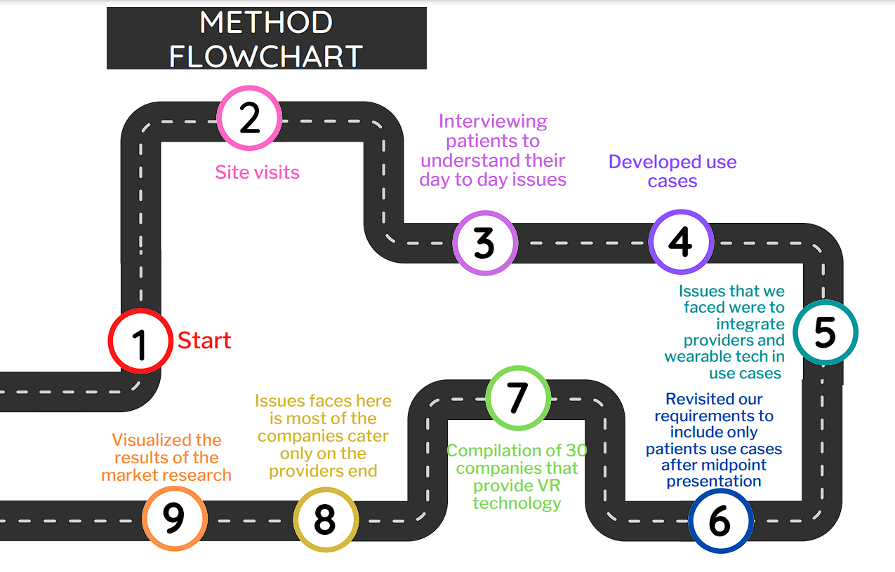
Method Flowchart
Methods
Met

Slide 8
Deliverables
We divided our deliverables into:
Comparative analysis of 30 VR technology vendors in healthcare
Use cases for VR technology
Exploration of potential partnerships with vendors by visualizing the spreadsheet data

Slide 9
Companies with VR technology in healthcare

Slide 10
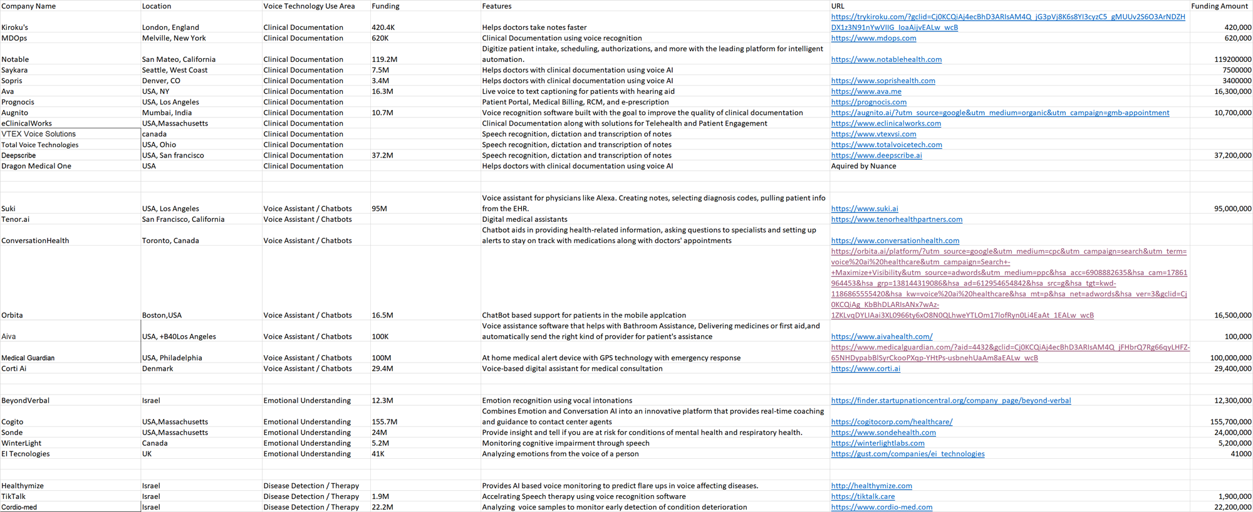
List of Voice Recognition Vendors

Slide 11
HIPAA Compliant device/Apps
Company Name | Location | Investment | Unit Cost
PicoVoice | Vancouver,BC,Canada | $500K (2020) | Free
Nuance | Burlington,MA,USA | NA | $200 for Home and $500 for Dragon Professional
nVoq | Boulder,CO,USA | $144M | $699
Dolbey Fusion Narrate power by nvoq | Boulder,CO,USA | NA | $850 Annual Cloud Subscription
Sensely | San Francisco,CA,United States | $26.8 M | Free(Mobile and Web Application)
ElliQ | Israel | $58M(Feb 2020) | Annual Subscription cost:$359.88
Sonde | Boston,MA,USA | $24M | Free App service

Slide 12
HIPAA Compliant device
Company Name | Location | Investment | Unit Cost
Amazon Transcribe Medical | Seattle,WA,USA | NA | Free 60 mins per month
Aiva Health | CA,USA | 100k | Free App service Standard Annually:11 euros per month
Google Assistant | Palo Alto,CA,USA | 55M | $99 device cost
Life Pod | Boston,MA,USA | $5M | Free Mobile and Web Application

Slide 13
Data Analysis and Visualization Results

Slide 14
VR Service Segmentation
Clinical documentation
Dictate to a device that records their voice and transcribes into a text document
To apply the dictated information on to the EHR
Disease detection/Therapy
With the help of vocal patterns and voice variance VR technology can be used to detect diseases
Emotional Understanding
Certain companies that use VR technology help its patients to monitor mental health
Mental problems such as depression can be detected
Voice assistant/Chatbots
Leading VR skills in the industry such as reminder, educational content are used to help the patients to run their daily routine
Notes:
Warren Barr South Loop
Madilyn

Slide 15
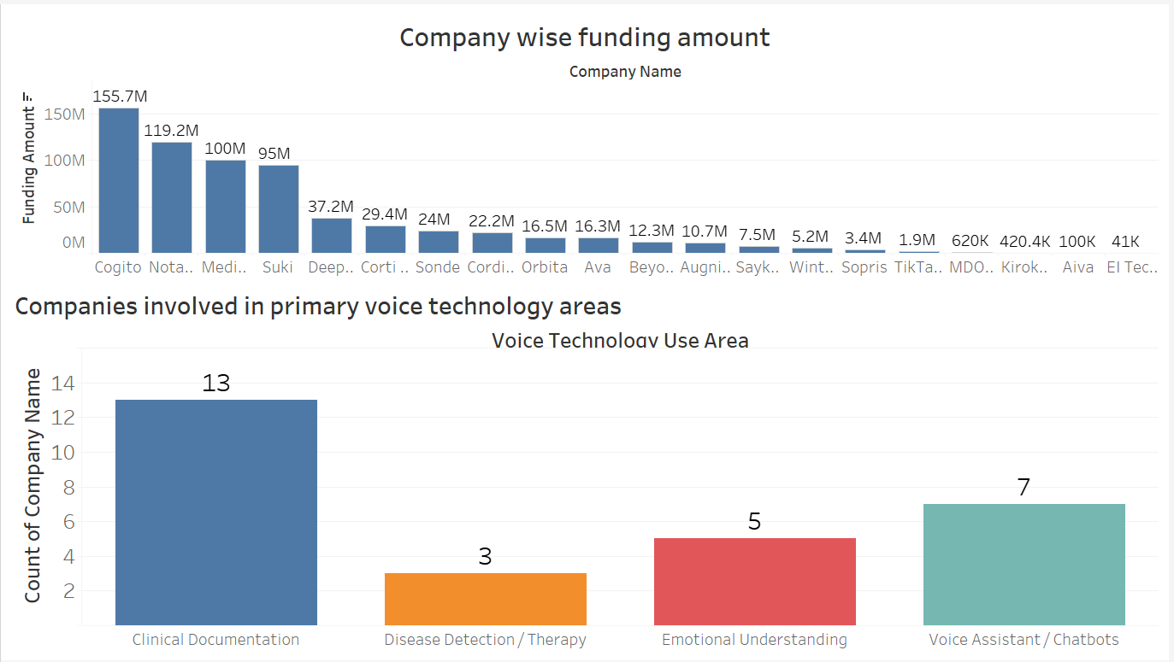
Comparative Analysis
Company wide funding amount

Slide 16
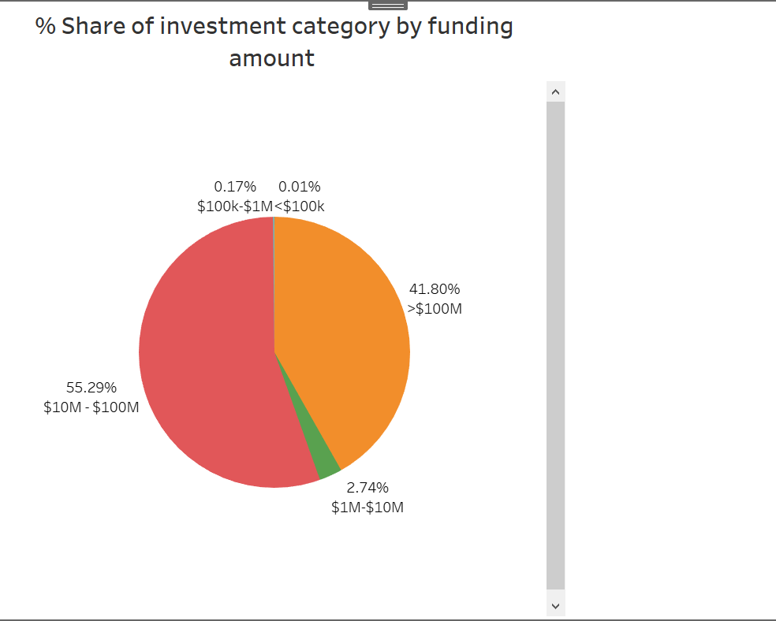
Comparative Analysis
Funding amount comparison of 28 VR companies in 4 service categories

Slide 17
Use Cases

Slide 18
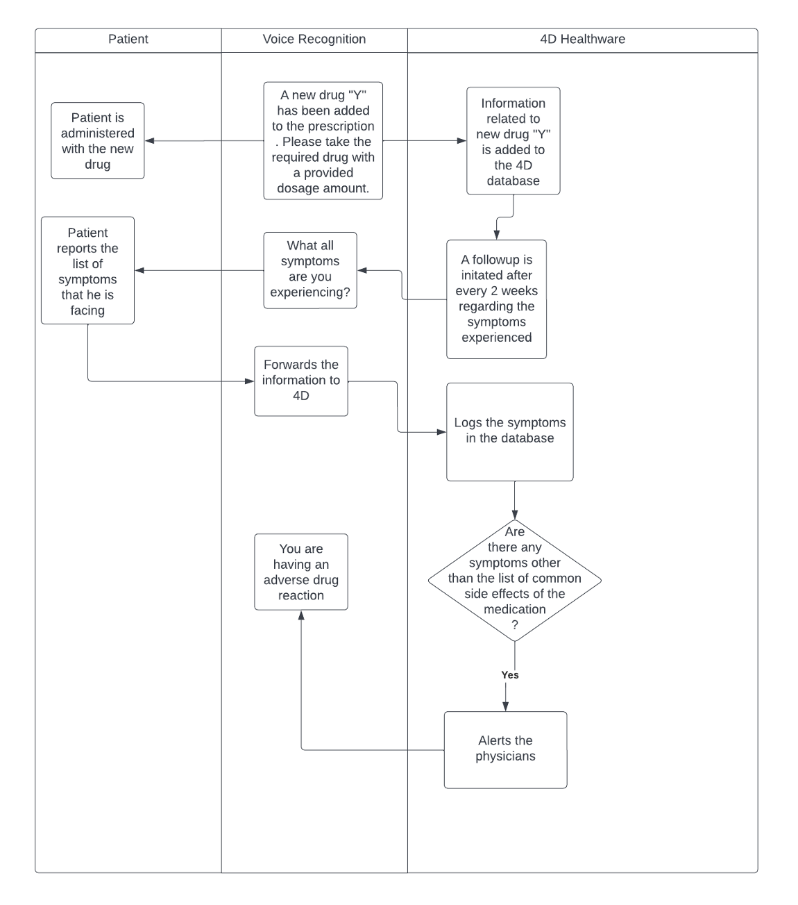
Use case 1:
Adverse Drug Reactions
Companies providing this service:
HealthTap
Sensely
ConversationHealth
Notes:
Problem Setting: Patient has already been diagnosed with an illness and has been prescribed a dedicated medication.A new drug has been added to clinical documentation.
Adverse Drug Reaction: It is defined as an appreciably harmful or unpleasant reaction, resulting from an intervention related to the use of a medicinal product, which predicts hazard from future administration and warrants prevention or specific treatment, or alteration of the dosage regimen, or withdrawal of the product.
Based on our research, we found out that allergic reactions occur within hours to two weeks after taking the medication and most people react to medications to which they have been exposed in the past. This process is called "sensitization."
Sources:
https://www.ncbi.nlm.nih.gov/pmc/articles/PMC3940361/
https://www.aaaai.org/tools-for-the-public/conditions-library/allergies/medications-and-drug-allergic-reactions

Slide 19
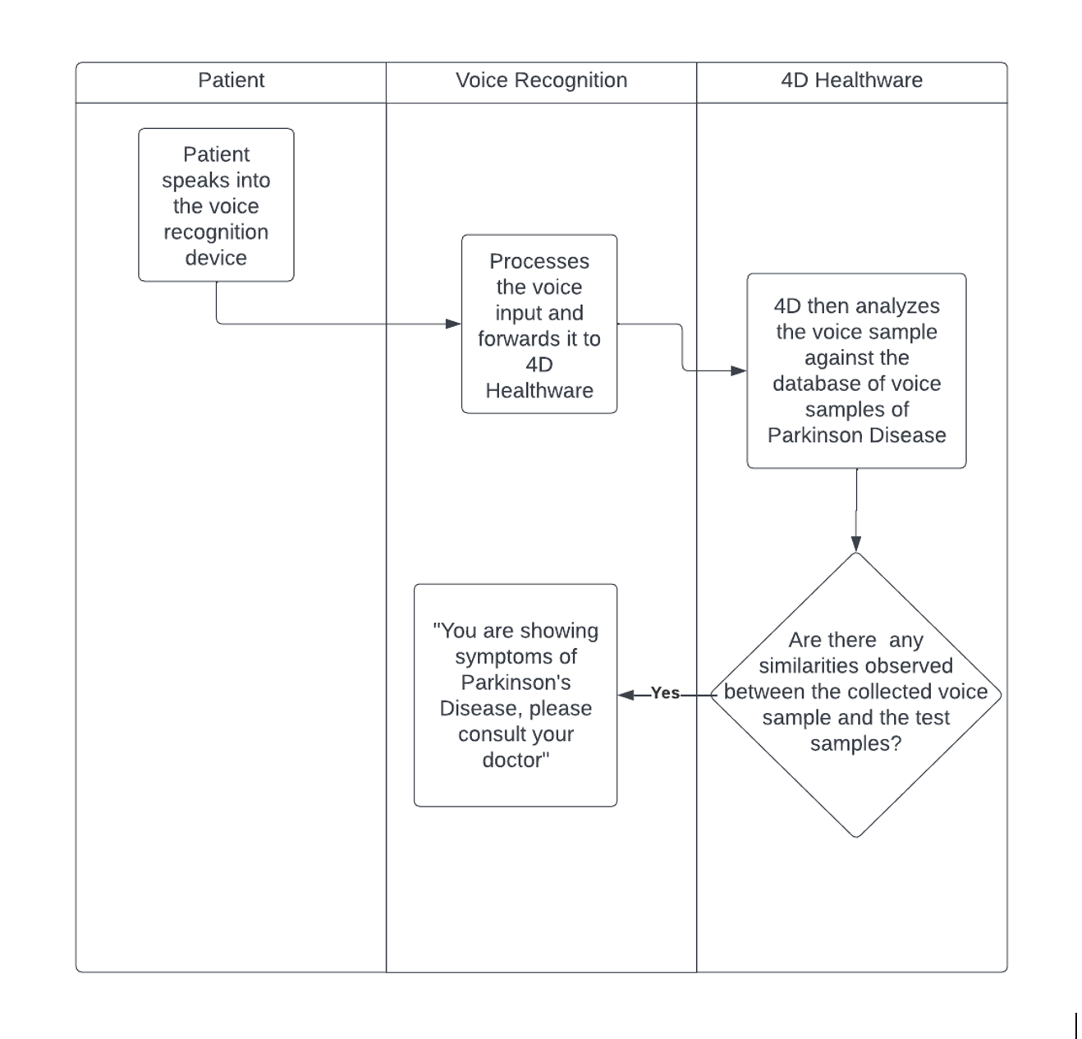
Use case 2:
Detection
Of Parkinson’s Disease
Companies providing this service:
Sonde Health
Healthymize
Rune Labs
tiktalk
Notes:
All voice collections supervised by clinician
Parkinson’s disease (their voice could be lower or they talk slower)
VR asks patient to say sounds, read sentences, and read full texts through the app.
Source - http://healthymize.com
Company based in Isreal detects flare ups in voice-affecting diseases such as asthma*, pneumonia* and COPD
https://www.technologynetworks.com/neuroscience/news/screening-app-detects-parkinsons-disease-from-voice-recordings-366331
https://parkinsonslife.eu/voice-assisted-technology/
https://www.mobihealthnews.com/news/anz/ai-based-voice-screening-app-australia-can-detect-parkinsons-diseases-severe-covid-19
Rune Lab - Company that uses voice to detect Parkinson’s disease
https://www.runelabs.io

Slide 20
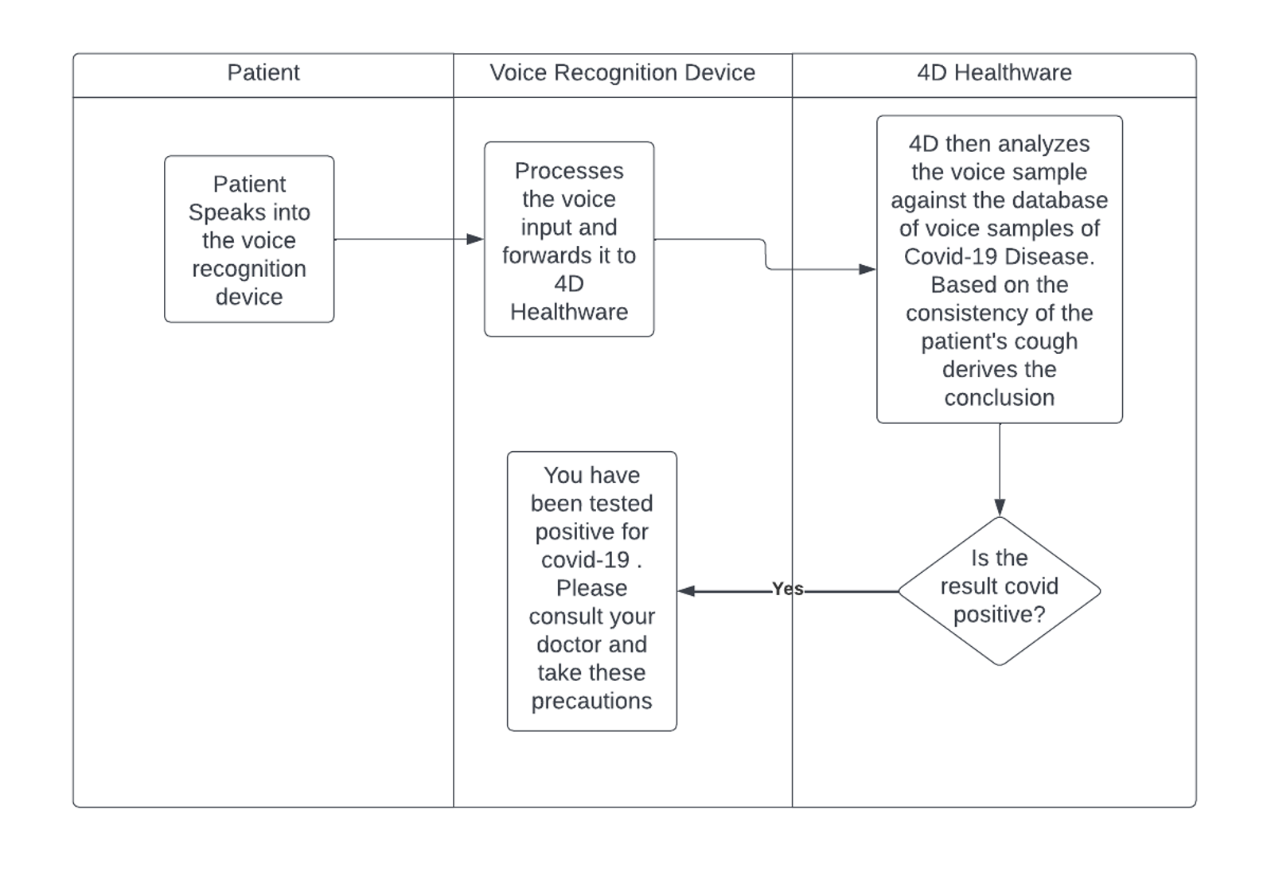
Use case 3:
Detection
Of Covid-19
Companies providing this service:
ResApp Health
Sonde Health
Healthymize
Notes:
All voice collections supervised by clinician
https://www.mobihealthnews.com/news/anz/ai-based-voice-screening-app-australia-can-detect-parkinsons-diseases-severe-covid-19
Rune Lab - Company that uses voice to detect Parkinson’s disease
https://www.runelabs.io
ResApp Health - Company based in Australia that uses voice to detect COVID - 19
https://www.resapphealth.com.au

Slide 21
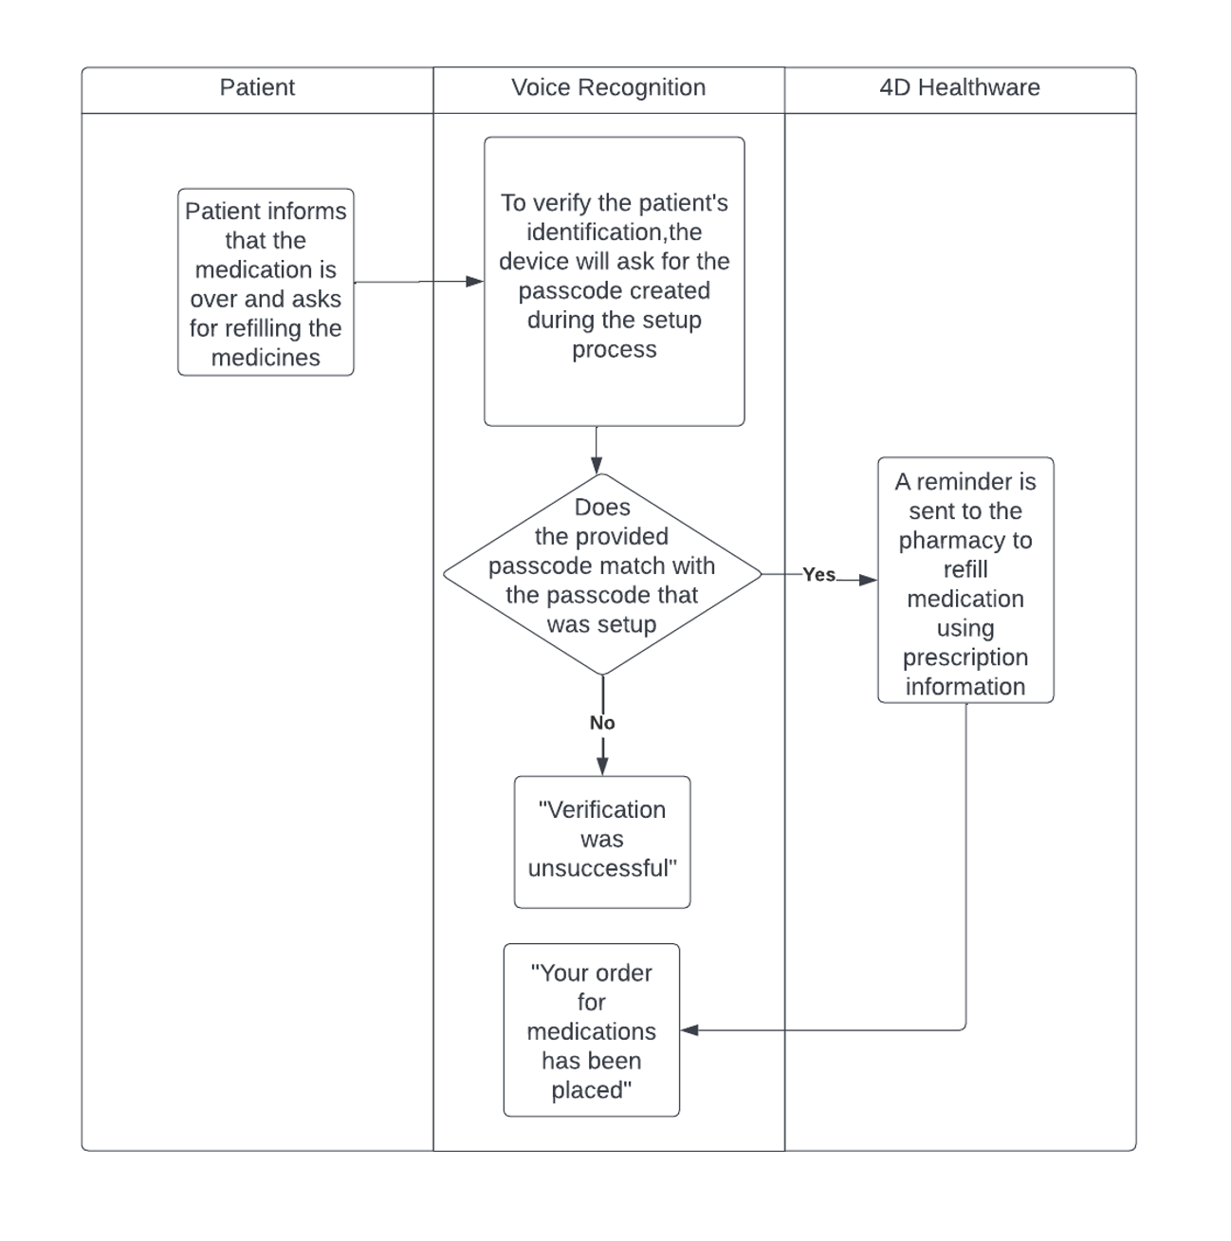
Use case 4:
Medication Restock Reminder
Companies providing this service:
Orbita
Aiva
ElliQ
Sensely
ConversationHealth
Notes:
https://www.cnet.com/home/smart-home/alexa-can-now-remind-you-to-take-your-medicine-heres-how-to-set-it-up/

Slide 22
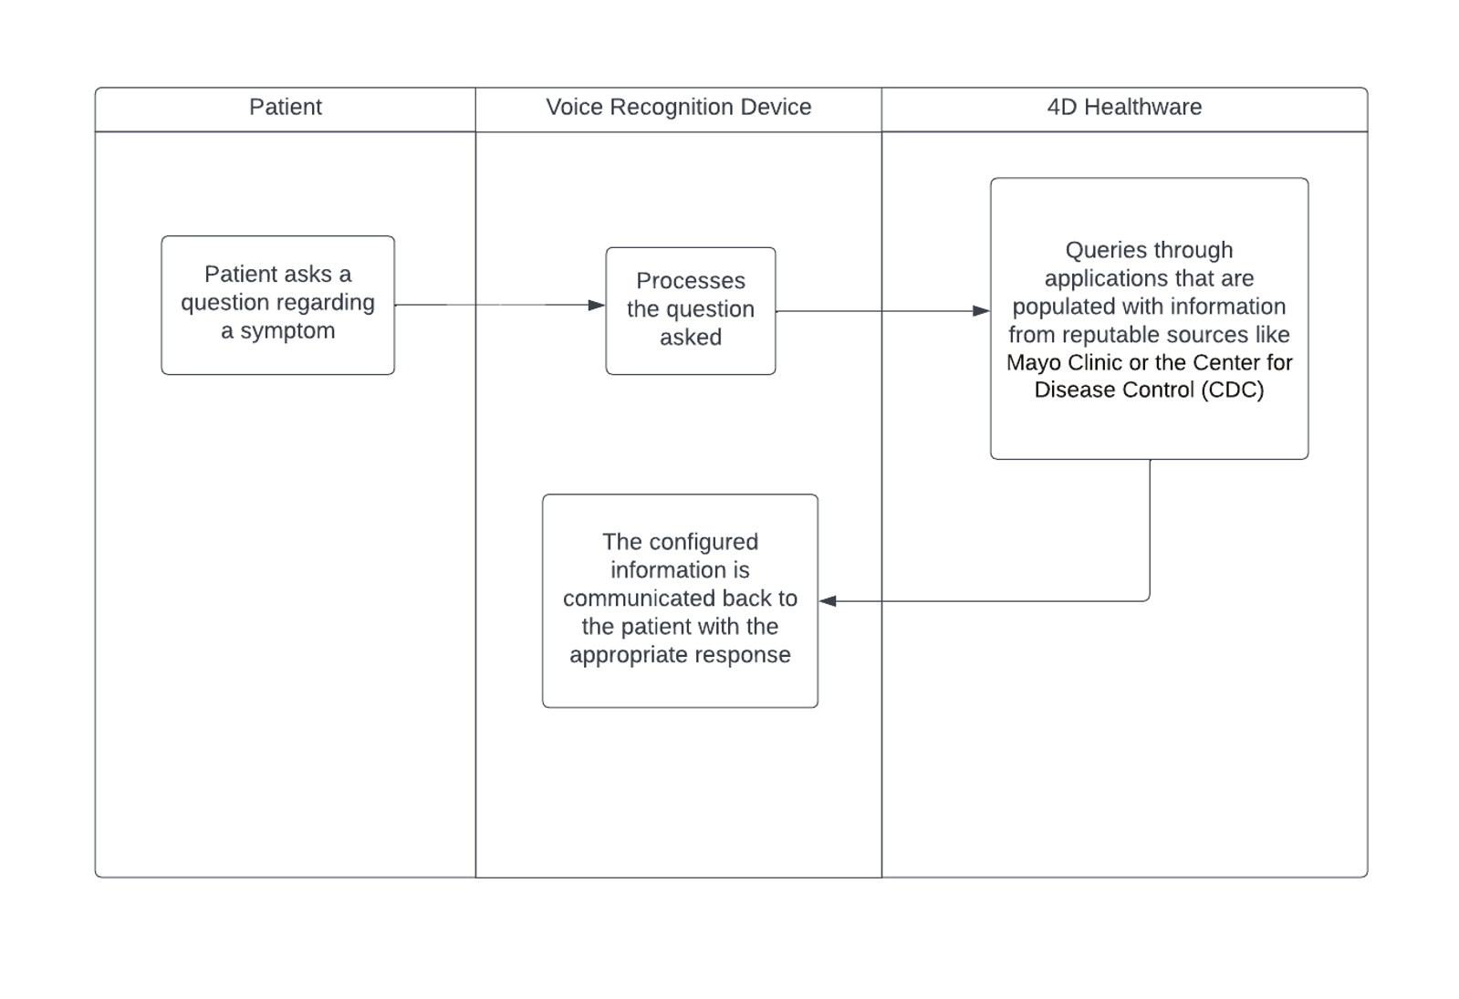
Use case 5:
Self Diagnosis
Companies providing this service:
Tenor.ai
ConversationHealth
Notes:
Example : Patient went to the garden and came back with a tick on its leg. Not knowing what to do further they will ask VR how to proceed.

Slide 23
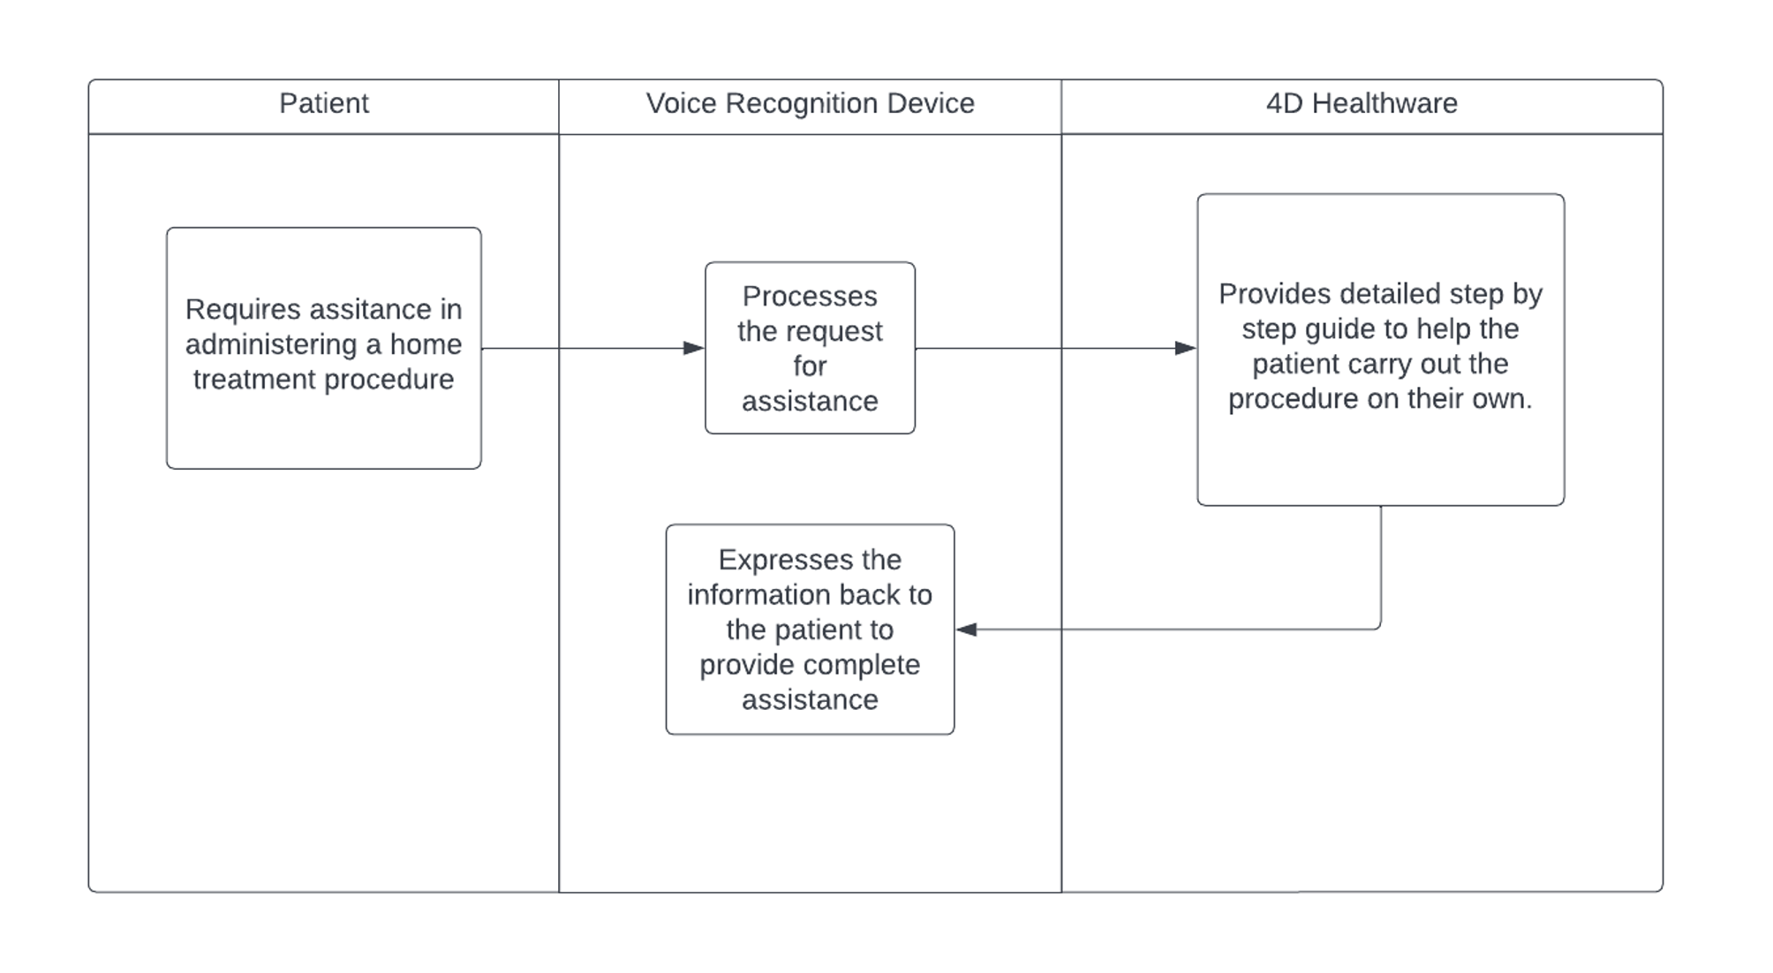
Use case 6:
Administer Treatment
Companies providing this service:
Medical Guardian
Orbita
Notes:
All voice collections supervised by clinician
https://www.mobihealthnews.com/news/anz/ai-based-voice-screening-app-australia-can-detect-parkinsons-diseases-severe-covid-19
Rune Lab - Company that uses voice to detect Parkinson’s disease
https://www.runelabs.io
ResApp Health - Company based in Australia that uses voice to detect COVID - 19
https://www.resapphealth.com.au

Slide 24
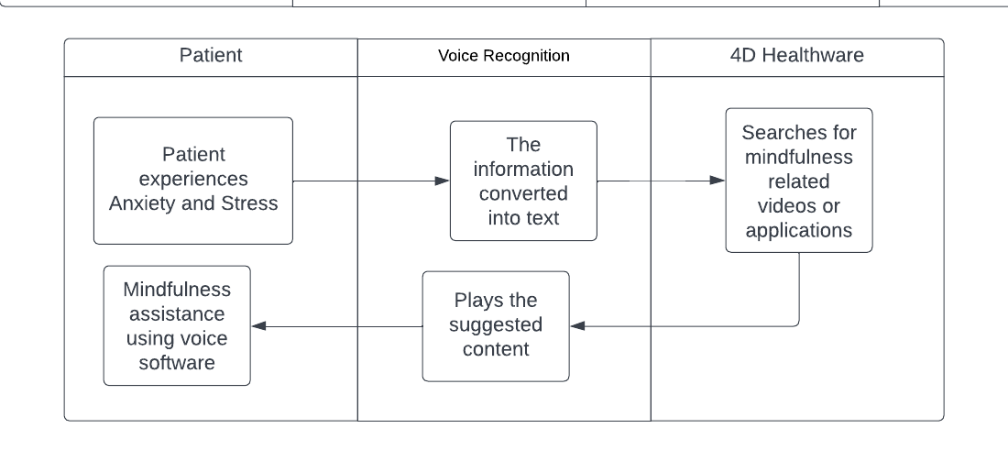
Use case 7: Mindfulness
Companies providing this service:
BeyondVerbal
Sonifi health
cogito
Suki
Tenor.ai
ConversationHealth
Orbita
Aiva
Medical Guardian
Corti Ai
ElliQ
Lifepod
CareAngel
Cardio Cube
Sensely
Notes:
Sources:
https://towardsdatascience.com/how-ai-voice-assistants-can-revolutionize-health-b08d925bd018
Beyond Verbal - It is a company based in Israel that claims to understand human emotions by analyzing raw voice intonations as people speak.
https://en.wikipedia.org/wiki/Beyond_Verbal
https://techcrunch.com/2013/05/08/beyond-verbal-gets-a-2-8m-seed-round-to-develop-voice-recognition-that-decodes-emotions/
Winter Light Labs -
https://winterlightlabs.com

Slide 25
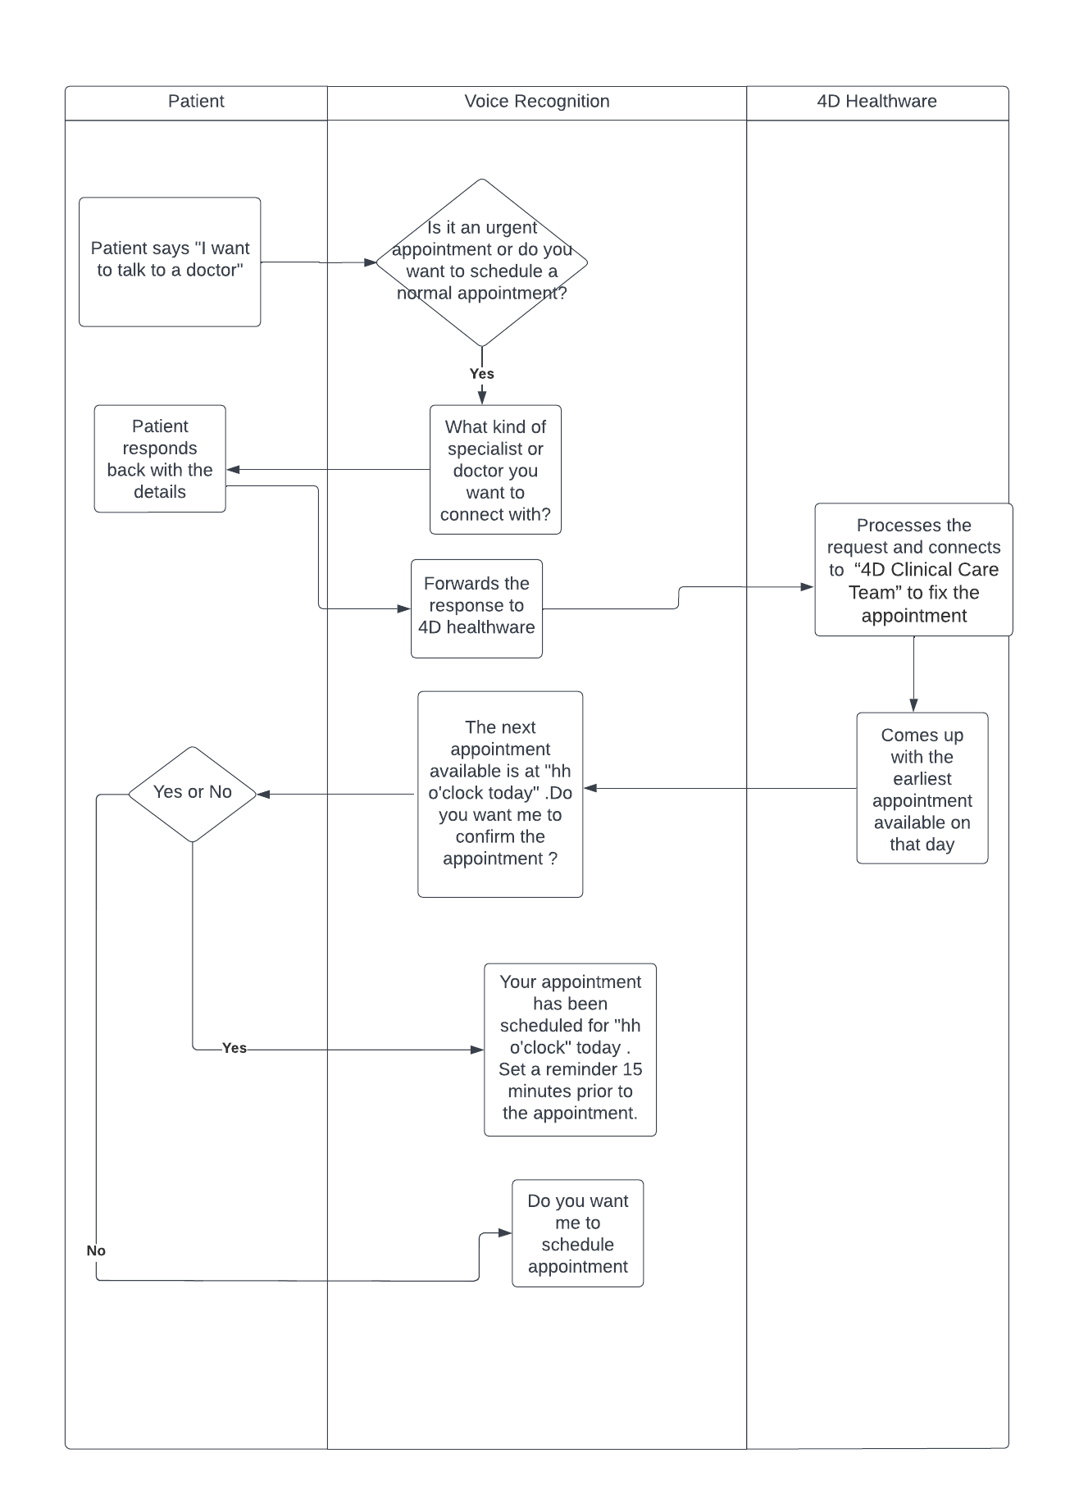
Use case 8: Initiate Telehealth for Urgent Care
Companies providing this service:
Suki
Tenor.ai
ConversationHealth
Orbita
Aiva
Medical Guardian
Corti Ai
ElliQ
Lifepod
CareAngel
Cardio Cube
Sensely
Notes:
Sources:
https://towardsdatascience.com/how-ai-voice-assistants-can-revolutionize-health-b08d925bd018
https://www.cnet.com/home/smart-home/you-can-now-use-amazon-alexa-devices-to-talk-with-a-doctor/
Beyond Verbal - It is a company based in Israel that claims to understand human emotions by analyzing raw voice intonations as people speak.
https://en.wikipedia.org/wiki/Beyond_Verbal

Slide 26
Summary
We found out 30 VR vendors in healthcare sector and 11 HIPAA compliant devices/applications that can partner up with 4D
Comparative analysis of these companies and services in the industry with respect to funding amount
Different use cases of VR technology that can be implemented by 4D

Slide 27
Future Scope
Here is what the next team should focus on:
Promote voice recognition for “Disease detection” and “Emotional Understanding”
Focus on community based support
Customizing the services
Reduced latency for emergency situations

Slide 28


